Slide 1
Important Pointers for the Idea Submission
Please ensure below pointers are met while registering
Kindly keep the maximum slides limit to 4 pages.
All the topics should be utilized for description of your idea
Try to avoid paragraphs and post your idea in points
Keep your explanation precisely and easy to understand
Idea should be unique and novel. If it has a business potential more weightage will be given.
Apart from this PPT abstract of your idea will be asked separately while submitting
You need to save the file in PDF and upload the same on portal. No PPT, Word Doc or any other format will be supported.
You can use own theme for the slides.
It is mandatory to have one faculty mentor associated with your team.
One Industry Mentor is most recommended (if you need guidance, please contact Faculty coordinators or write to director.vnest@vit.ac.in
At least on girl student participant is required per team.
You can delete this slide (Important Pointers) when you upload the details of your idea on KAVACH PORTAL.

Slide 2
Basic Details of the Team and Problem Statement
PSID (Problem statement ID) : KVH-005
(Click here- https://kavach.mic.gov.in/kavach2023PS )
Problem Statement Title: Advanced ANPR & FRS solution
Team Name: Enigma Decoders
Team Leader Name: Prathamesh Potabatti
Institute Code (AISHE):C-49441
Institute Name: Vellore Institute of Technology, Chennai

Slide 3
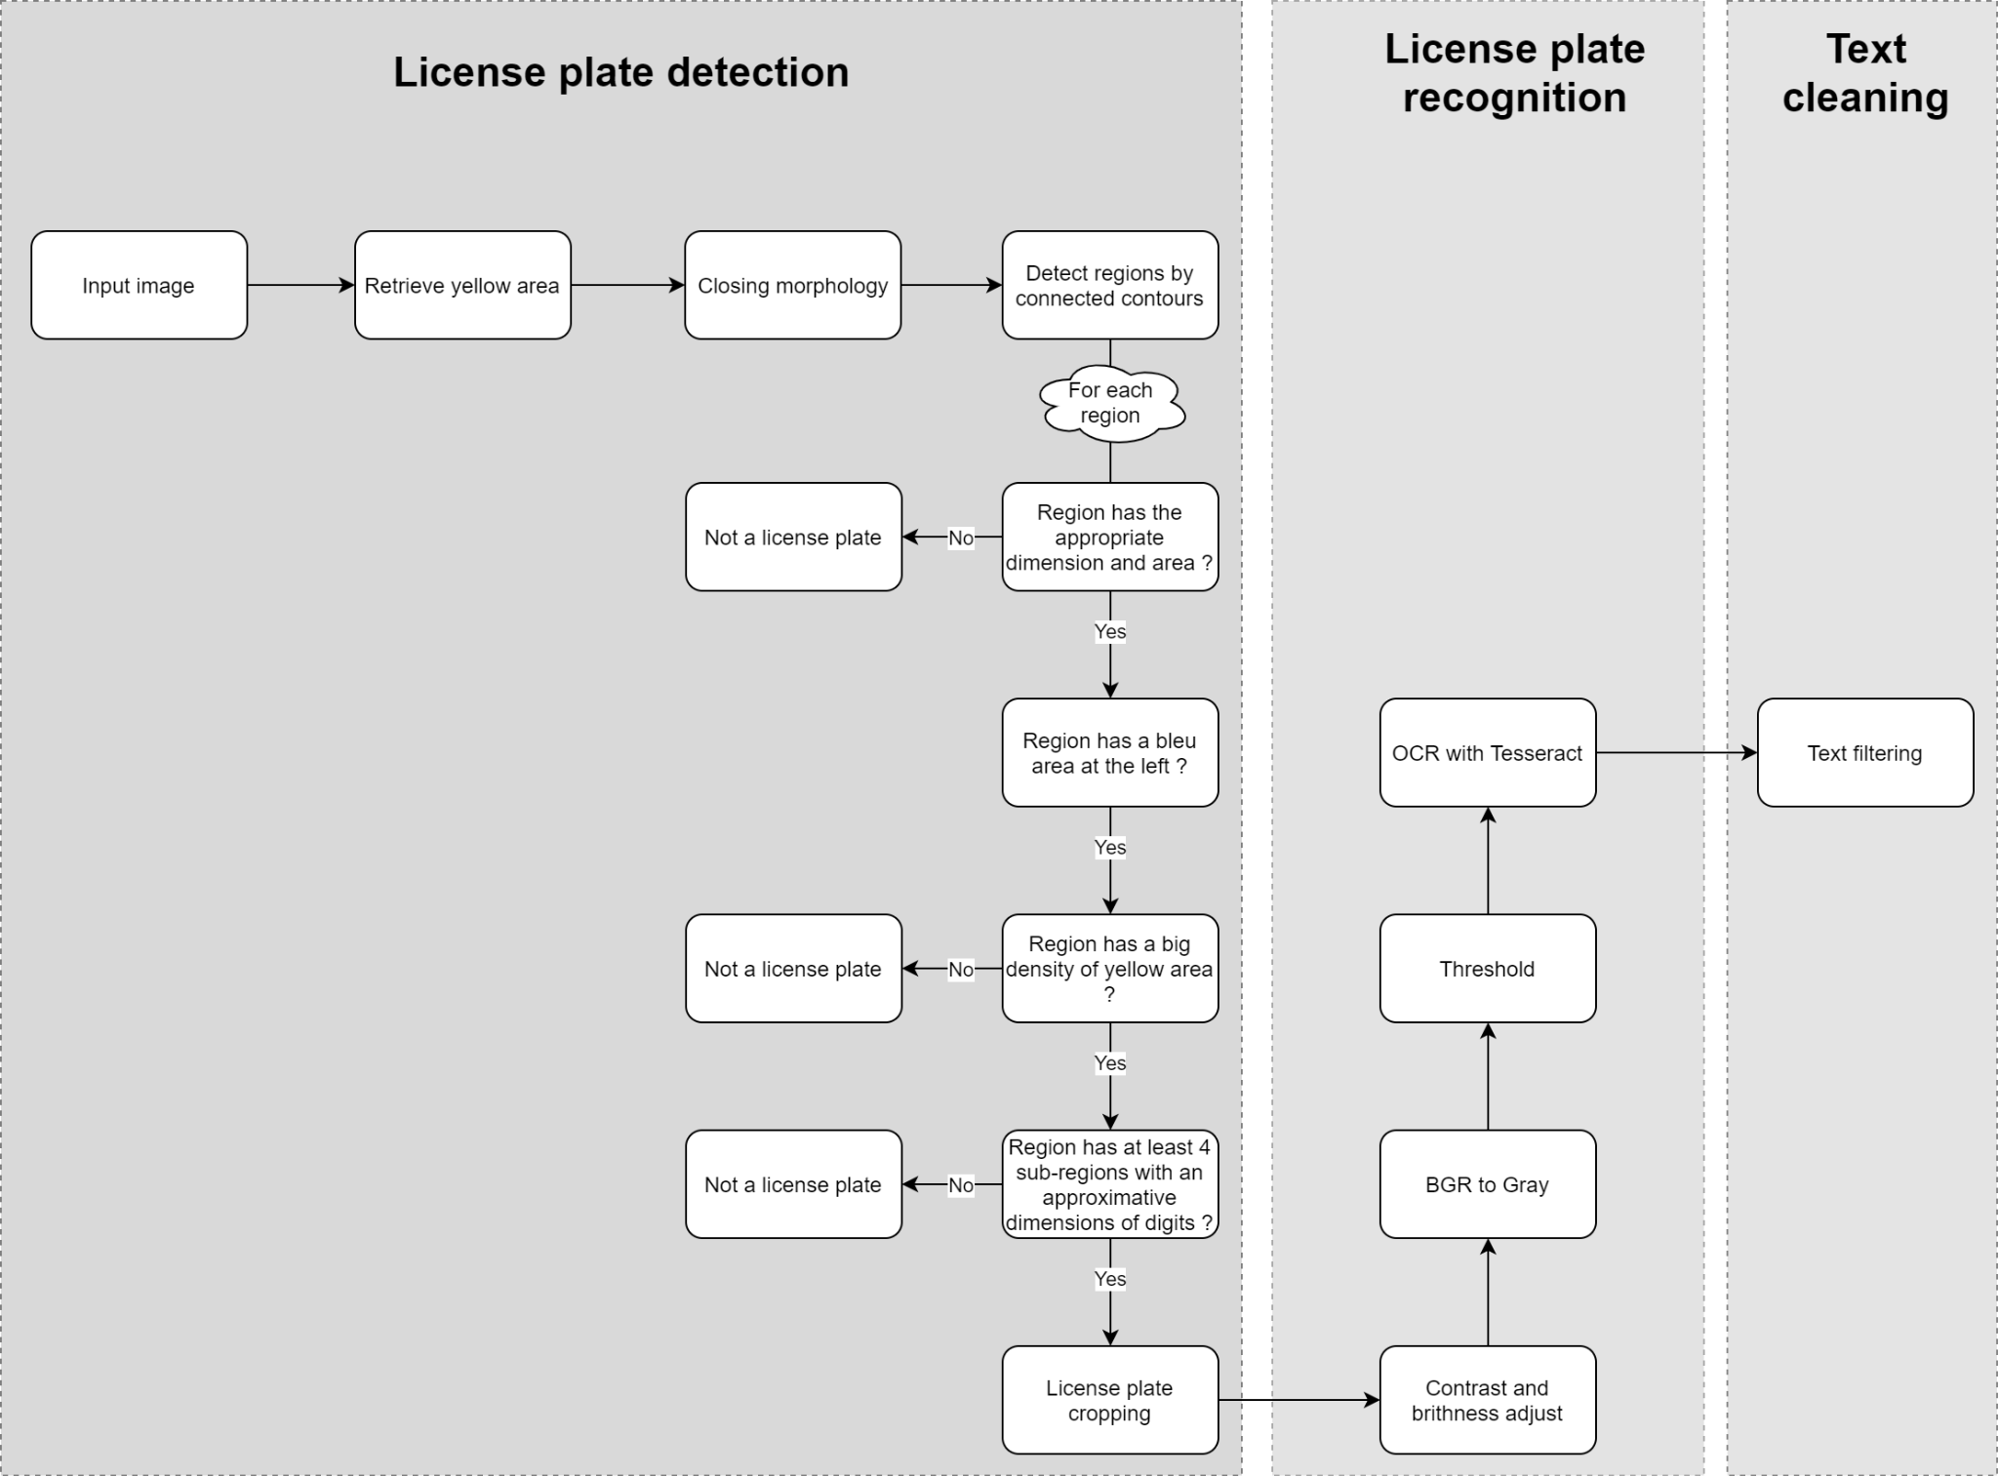
Idea/Approach Details
Describe your idea/Solution/Prototype here:
The main goal of this project is to implement an automatic number plate recognition system from a CCTV footage. From the CCTV video footage we have to extract the characters on the number plate of the ongoing cars. Another feature which we would be adding to this project is face recognition. We have to extract the number plate and the face of the driver and store the face image and the number plate as text in a backend database.
We will be using CRNN algorithm to detect and record the number plate of the cars. We first have to train the Deep Learning model on a large datasets of car number plates. The dataset has to be augmented for better accuracy of the model. First, we focus on extracting the number plate, i.e., train the model to detect and draw a bounding box on the number plate. Then, we pass this to a Language processing model which uses LSTMs or Transformer based models to extract the textual content. Later, we will store this information into the database.
Add process flow chart or simulated image of prototype or any relevant image related to your idea
Describe your Technology stack here:
Python
OpenCV
Tensorflow

Slide 4
Idea/Approach Details
Describe your Dependencies / Show stopper here
(*Dependency means something without which your project cannot be developed...could be hardware or software...
*Show stoppers are threats that can arise and can delay the development of the solution...)
Describe your Use Cases here (a specific situation in which a product or service could potentially be used)
Useful for speed cameras to detect if any driver is overspeeding and then capture his face and his car details.This system can be used on speed cameras to detect if any driver is overspeeding and then capture his face and his car details.
Huge parking lots can also use this system for better management of cars and keeping a record of who has entered and who has exited the parking lot along with the time stamps.
Implemented on tolls to capture the driver and the car details.
Airports can also make use of this to manage their parking lots and charge the drivers according to their waiting times.
We would require video footages of on road traffic. We will be applying our trained model on this video footage and test if it is successfully able to detect the number plate and extract the text.
Video footage data is available online. We can use online datasets.
One of the major problems we may face during the implementation of this system is that it may take a very long time to train the OCR model. Considering that the model is supposed to be trained on a large dataset to be accurate.

Slide 5
Team Member Details
Sr. No. | Name of Team Member | Branch (Btech/Mtech/PhD etc): | Stream (ECE, CSE etc): | Year | Position in team (Team Leader, Front end Developer, Back end Developer, Full Stack, Data base management etc.)
1 | Prathmesh R Potabatti | BTech | CSE with AI & ML | 3rd Year | Team Leader
2 | Chirag Chandrashekar | BTech | CSE with AI & ML | 3rd Year
3 | Gomathi L | BTech | CSE with AI & ML | 3rd Year
4 | Sneha C Shakar | BTech | CSE with AI & ML | 3rd Year
5 | Bhuvaneshwari R | BTech | CSE with AI & ML | 3rd Year
6 | Jahnavi Thondepu | BTech | CSE with AI & ML | 3rd Year
Team Mentor/s Details (Mandatory)
Sr. No. | Name of Mentor | Category (Academic/Industry): | Expertise (AI/ML/Blockchain etc): | Domain Experience (in Years )
1 | Dr. Nachiyappan S | Academic | Cybersecurity | 10
2

